Slide 1

Crime and Communities
Classification Analysis of High and Low Crime Rates
Anustha Shrestha

Slide 2
Introduction
Objective: Predict whether a community has a “High Crime Rate” or “Low Crime Rate” based on socio-demographic indicators
Violent Crime is defined as the sum of crimes such as murder, rape, robbery and assault
Original Dataset: n = 2215, p = 147
https://archive.ics.uci.edu/ml/datasets/Communities+and+Crime
Extracted from: https://www.kaggle.com/kkanda/analyzing-uci-crime-and-communities-dataset/data
Final Dataset: n = 1994 , p = 101
Missing variables
Missing observations
Median per capita violent crime rate = 374
Classes: High Crime Rate (1) – Above median per capita violent crime rate
Low Crime Rate (0) – Below median per capita violent crime rate
- Balanced data

Slide 3
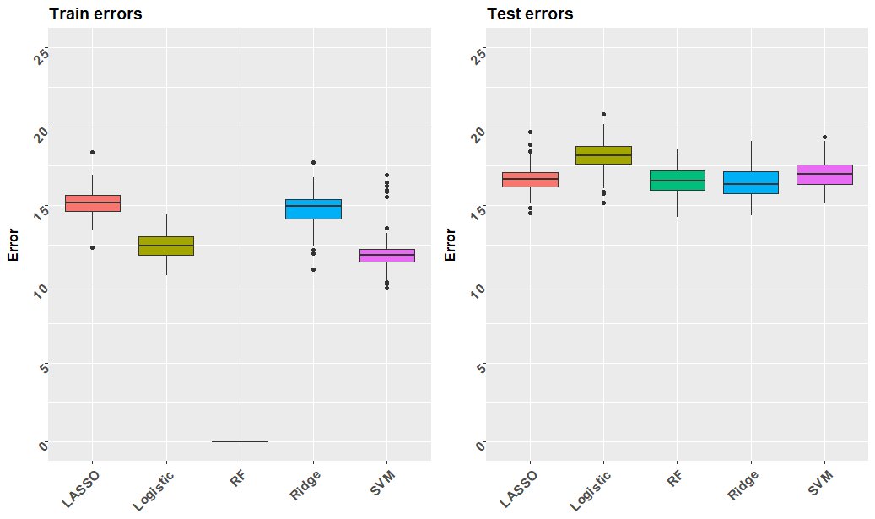
Error Rates | n_{learn} = 0.5n
Train errors: Lower than test errors
Random Forest: Lowest train errors, but high test errors (overfitting)
Logistic: Highest test errors
SVM train errors are good, but for test set, ridge performs better

Slide 4
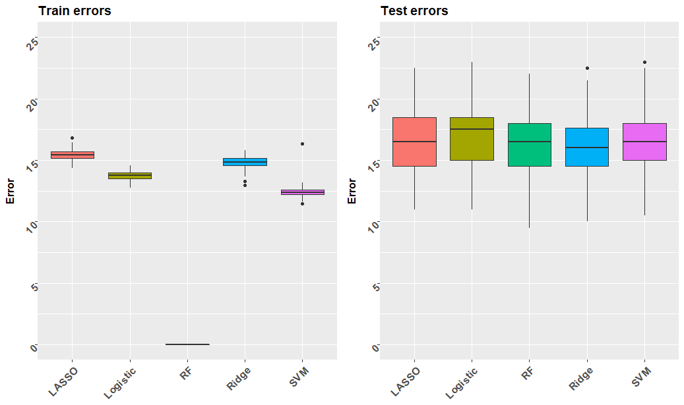
Error Rates | n_{learn} = 0.9n
Train errors: Similar to n_{learn} = 0.5n; slightly less variable
Test errors: Slightly lower than n_{learn} = 0.5n, but more variable
Random Forest: Lowest train errors, but high test errors (overfitting)
SVM train errors are good, but for test set, ridge performs the best

Slide 5
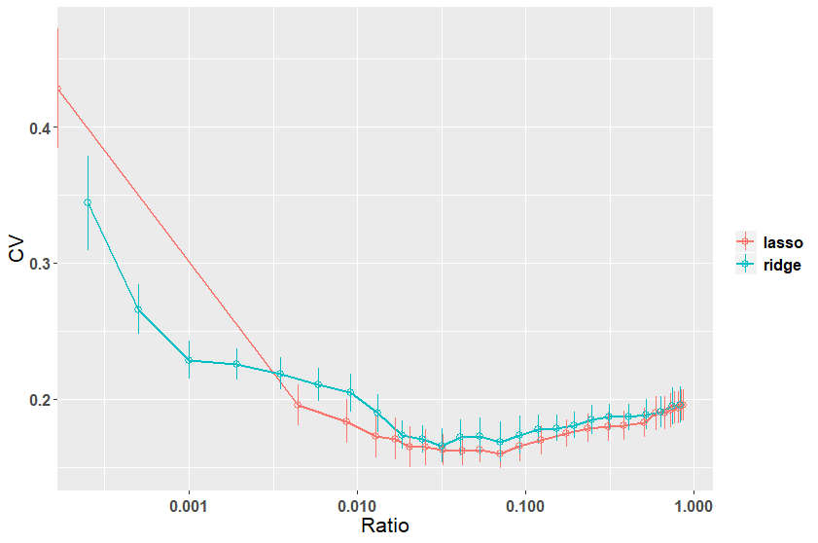
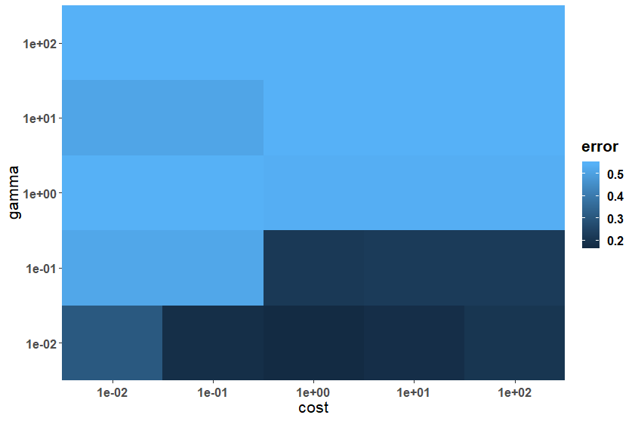

10-fold CV Curves and Heat Map | n_{learn} = 0.5n
Ratio : ${\left\|β_{λ}\right\|}_{2} / {\left\|β_{λ=0}\right\|}_{2}$ | Time: In seconds
As the $λ$ decreases (Ratio increases), first the CV error reduces, and after a point, it starts increasing. The optimal lamda is:
Lasso: $λ$= 0.0031 , CV = 0.1644
Ridge: $λ$= 0.0033 , CV = 0.1664
SVM: $γ$= 0.01 , cost = 1, CV = 0.1765
No clear trade off between time and predictive performance

Slide 6
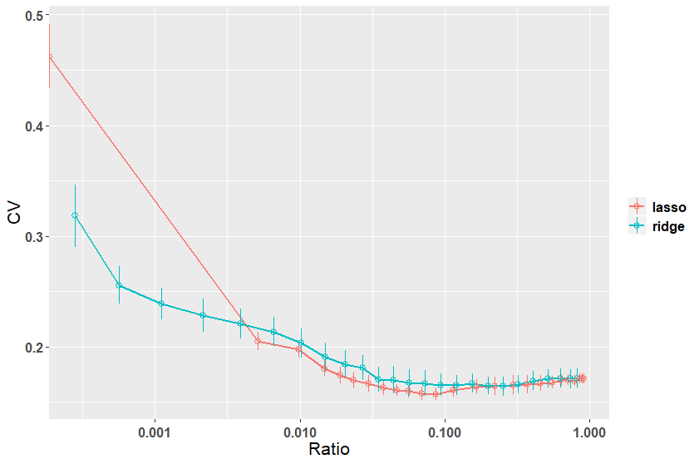
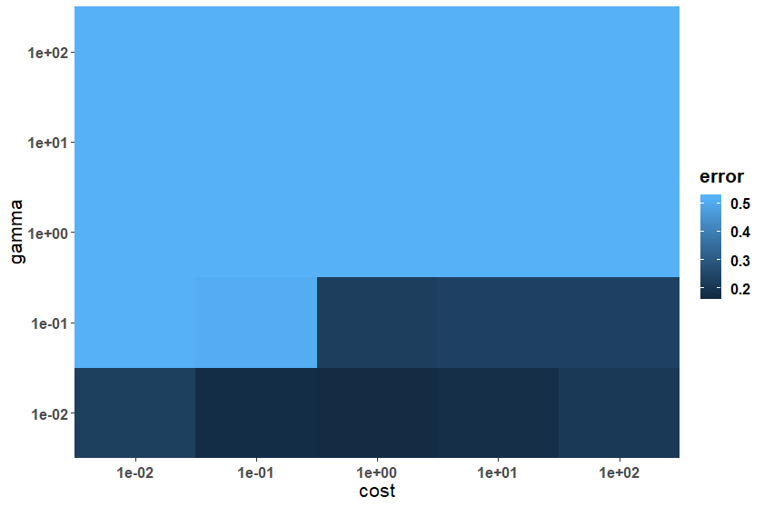
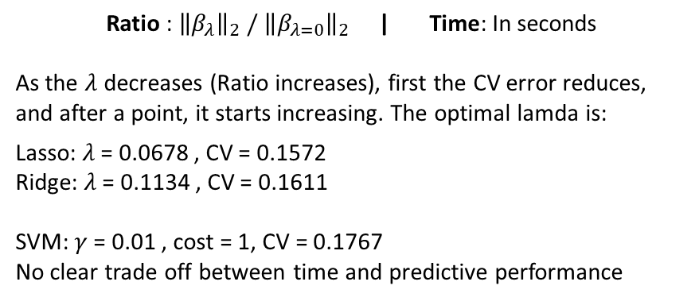
10-fold CV Curves and Heat Map | n_{learn} = 0.9n
Ratio : ${\left\|β_{λ}\right\|}_{2} / {\left\|β_{λ=0}\right\|}_{2}$ | Time: In seconds
As the $λ$ decreases (Ratio increases), first the CV error reduces, and after a point, it starts increasing. The optimal lamda is:
Lasso: $λ$= 0.0678 , CV = 0.1572
Ridge: $λ$= 0.1134 , CV = 0.1611
SVM: $γ$= 0.01 , cost = 1, CV = 0.1767
No clear trade off between time and predictive performance

Slide 7
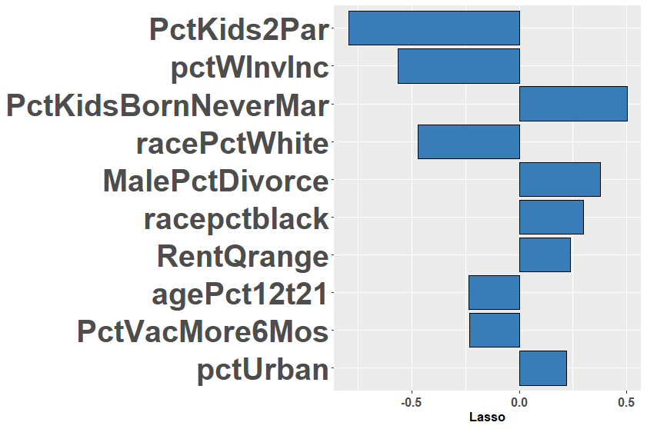
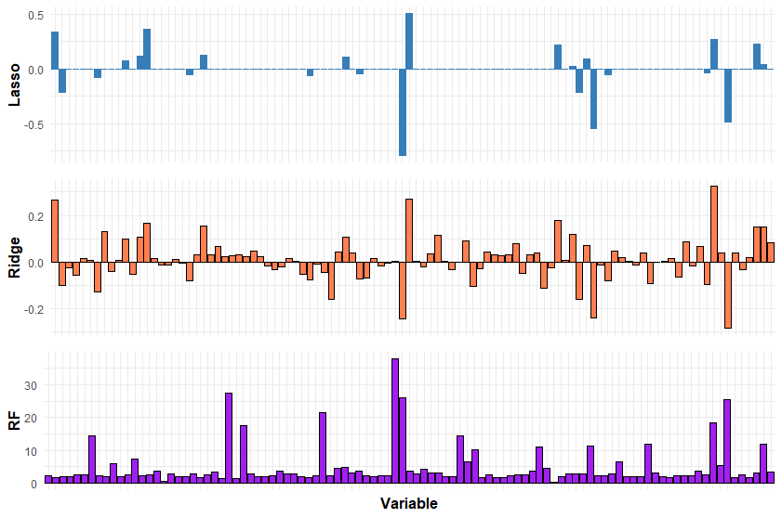
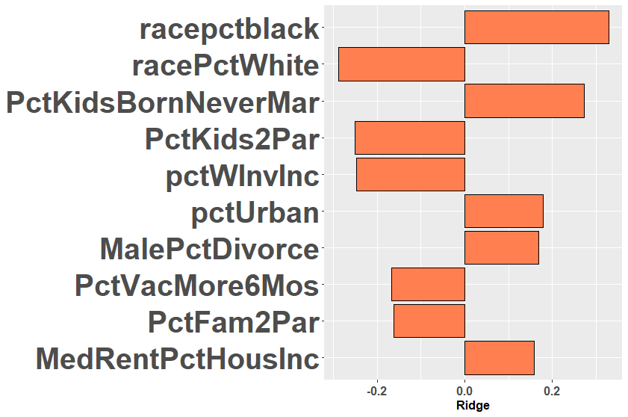
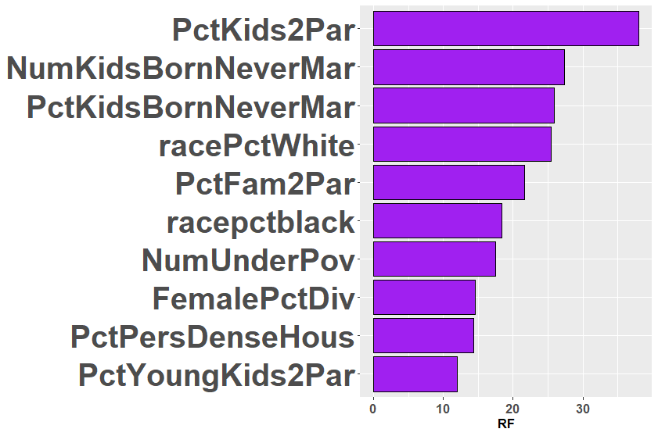
Coefficients | n_{learn} = 0.5n
* The purpose of this slide is to explore variables that are considered more important in the models. This does not establish any causality.

Slide 8
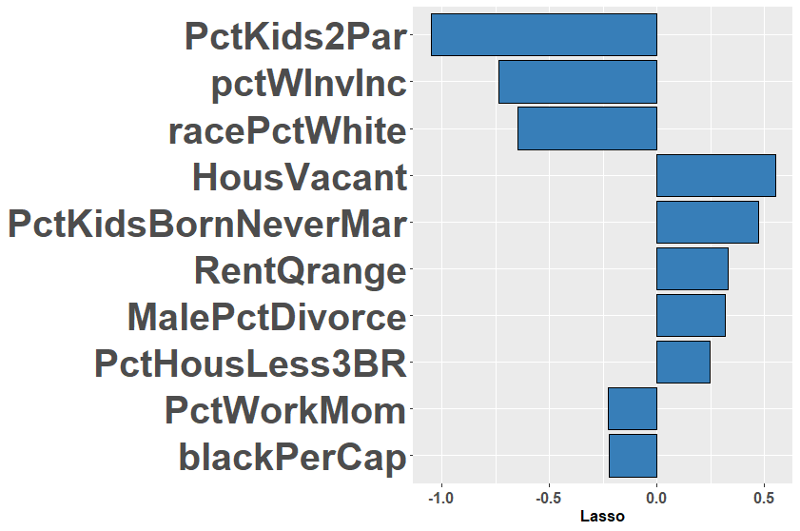
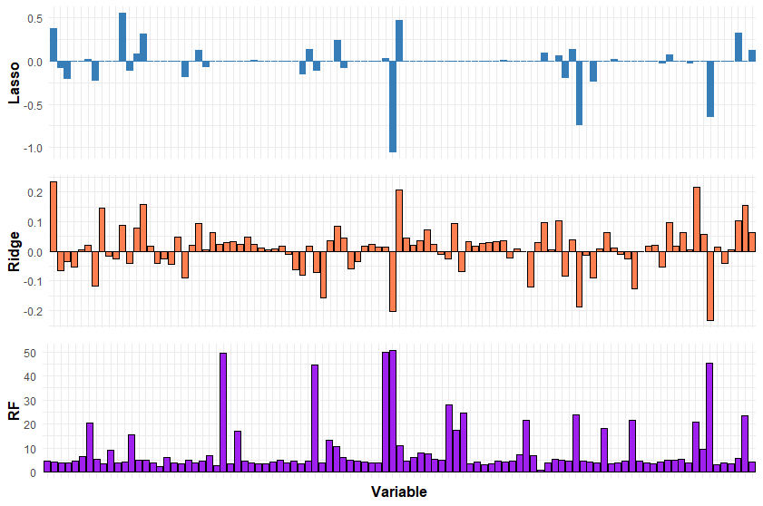
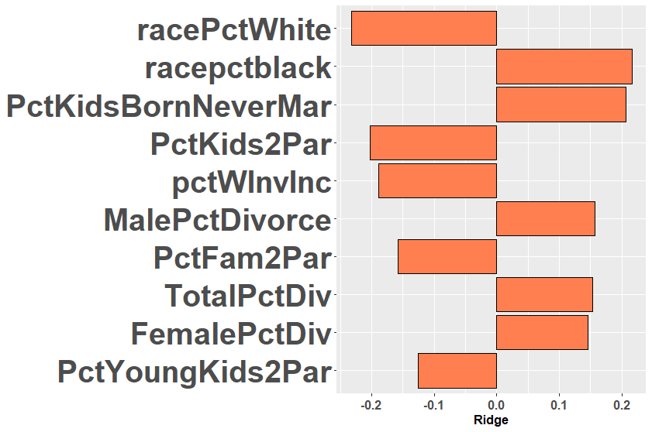
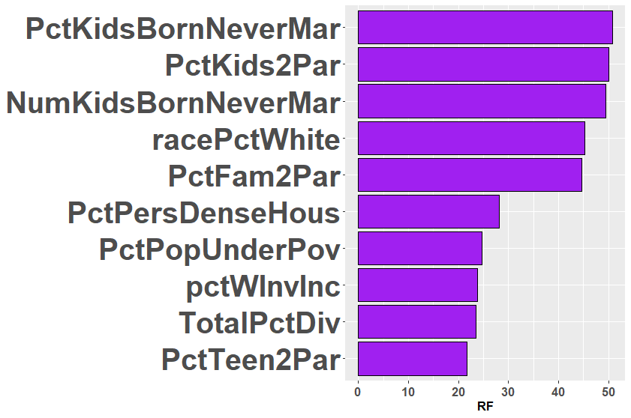
Coefficients | n_{learn} = 0.9n
* The purpose of this slide is to explore variables that are considered more important in the models. This does not establish any causality.

Slide 9
Conclusion
Prediction power - ~17% error rate of the methods described here is not as strong as the analysis we have seen in earlier predictions
Time vs. Performance- No clear trade off between time and predictive performance (SVM takes the longest, but Lasso/Ridge has better predictive performance)
Best Method: Given the complexity and computational time, and comparable performances of all the methods, Logistic Ridge is the best method

Slide 10
APPENDIX

Slide 11
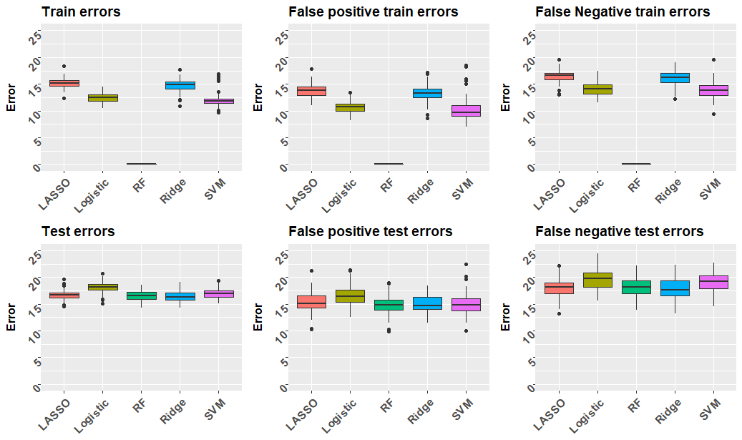
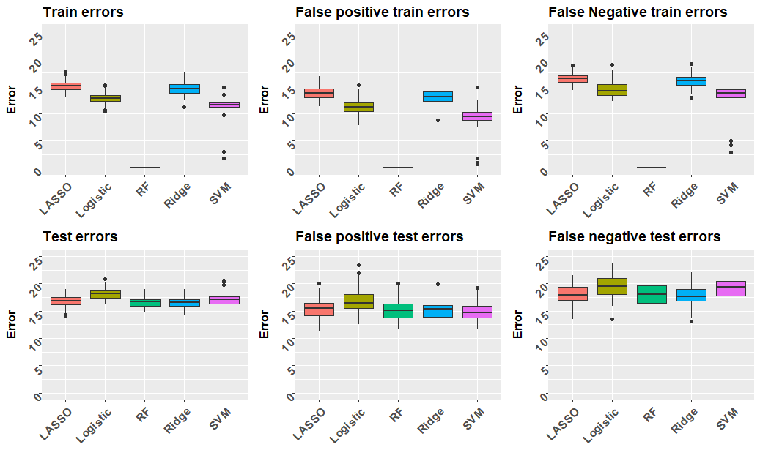
False Positive and False Negative Error Rates | n_{learn} = 0.5n
Imbalanced
Balanced
These plots show the false positive and false negative train and test error rates for imbalanced and balanced sample sets
In order to make the sample set balanced, oversampling was applied to the label that was underrepresented
Since the original data itself was a balanced set, oversampling does not change the result much

Slide 12
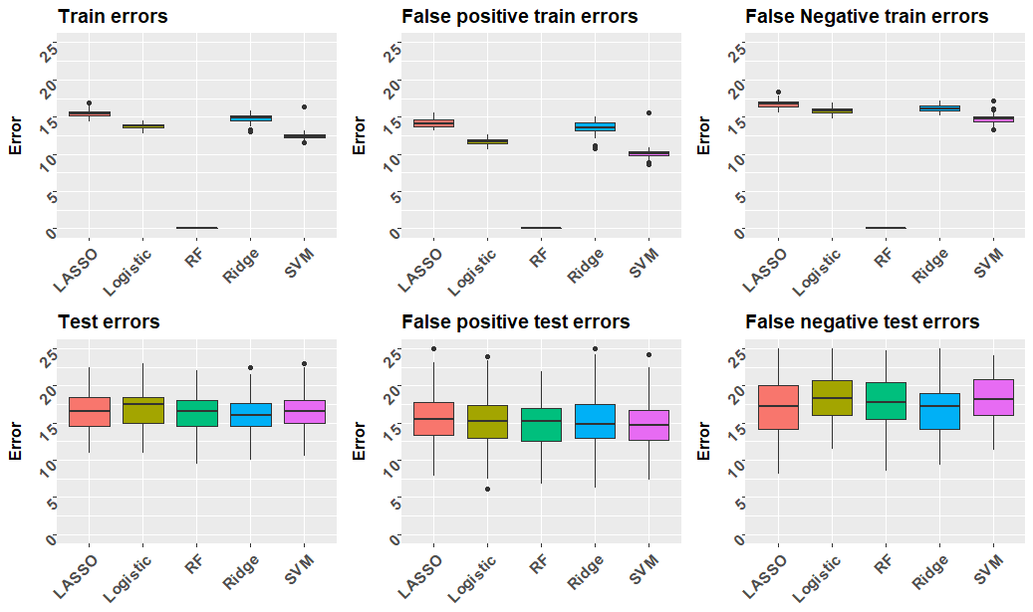
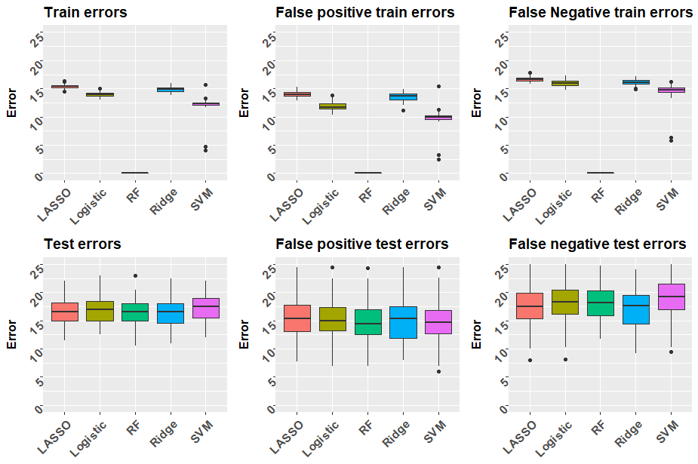
False Positive and False Negative Error Rates | n_{learn} = 0.9n
Imbalanced
Balanced
These plots show the false positive and false negative train and test error rates for imbalanced and balanced sample sets
In order to make the sample set balanced, oversampling was applied to the label that was underrepresented
Since the original data itself was a balanced set, oversampling does not change the result much

